Slide 1
INVENTORY MANAGEMENT SYSTEM (IMS)
FOR CALCULATION AND ORDERING OF AVAILABLE AND PROCESSED RESOURCES OF AN ALUMINIUM STORE

Slide 2
Introduction
Inventory Management is one of the basic problems for a company.
It may cause a lot of paperwork, if there is no automated system available.
This presentation provides an overview of the entire project with purpose, scope, definitions and overview of the INVENTORY MANAGEMENT SYSTEM.

Slide 3
Product Scope
Purpose
The purpose of the application is to maintain the records of stock, billing, details of In, Out of the product and their current stock positions with the company.
Benefits
The application will help the task maintaining the inventory in a much more organized way.
Currently it involves lot of paper work thus requires time and is also prone to error thus the benefit with a new online system would be that work could be done much faster and in a much more accurate manner.

Slide 4
Product Scope
Benefits cont….
As this is generic software it can be used by a wide variety of outlets (Retailers and Wholesalers) to automate the process of manually maintaining the records related to the subject of maintaining the stock and material flows.
This is a fast and accurate process.

Slide 5
Product Scope
Objectives
The main objective is to maintain the inventory records of a generic shop which deals in aluminium items.
To keep accounts of Goods in, Goods Out
To know the current position of the Stock
Transaction report
Stock maintenance

Slide 6
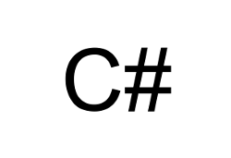

Technology Used
Front End
Front end id developed in C#.NET
Back end
Back end is developed in MySQL Workbench 6.1 CE.

Slide 7
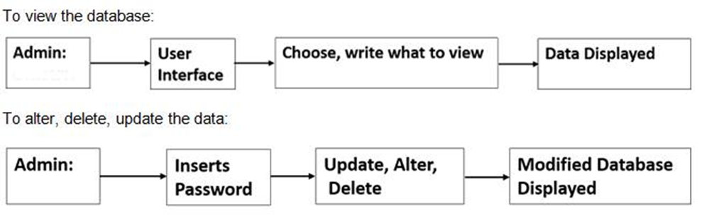
System Design

Slide 8
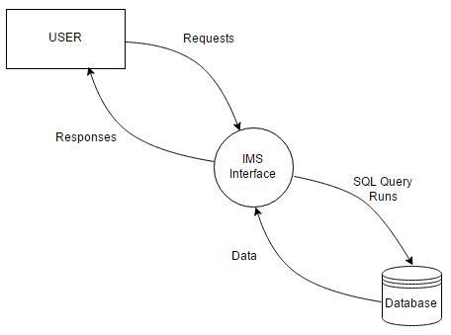
DFD

Slide 9
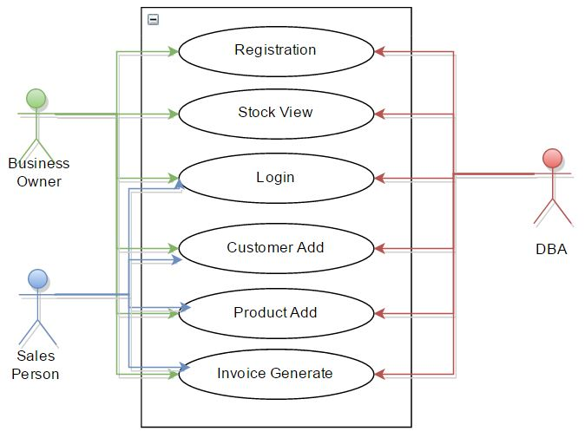
Use Case Diagram

Slide 10
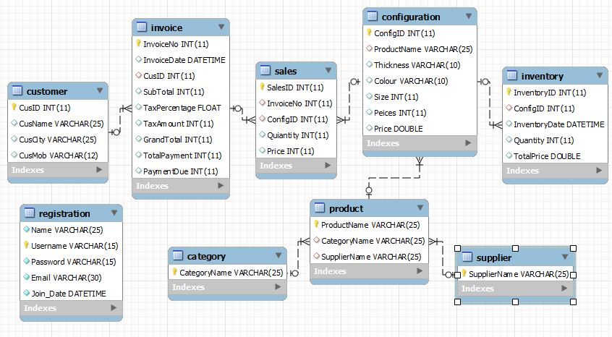
Schema Diagram

Slide 11
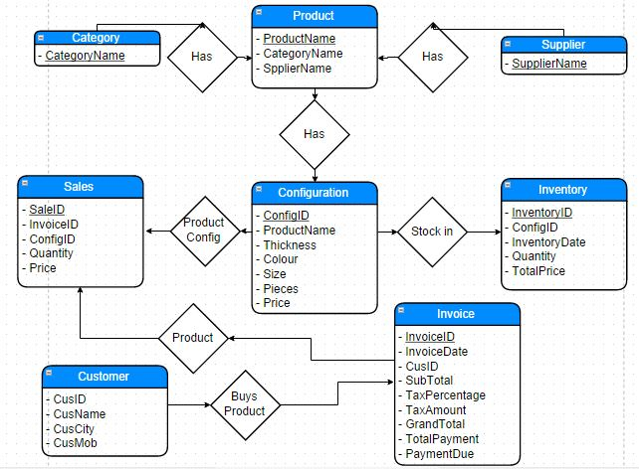
ER Diagram

Slide 12
Conclusion:
This Desktop application provides an easy way to manage Inventory. This application is developed and designed in such a way that any further enhancements can be done with ease.
This application is going to be used for the company to easily manage their stock. So, we are happy to develop this application as it provides all the functionalities required by the company.
Future Expectations:
We will surely expand this project and will add features like:
Employee Management
Salary Management
Automated Attendance System

Slide 13


